Slide 1
Authorship Identification with Amazon Review Data
Xiaohui Chen

Slide 2

I love this cellphone
This cellphone worked like a bomb and it totally ruined my life!!!
Whatever, I don’t care
Buyer 1
Buyer 2
Buyer 3

Slide 3
An Anonymous Text comes in for another product
“This laptop looks as if it is going to explode because it is always overheating. My life is destroyed by that thing!!!”
Most likely from buyer 2

Slide 4
Steps
Feature Extraction
Build ML Model
Tune Model
Prediction

Slide 5
Dataset
Amazon review data in which all users and items have at least 5 reviews (41.13 million reviews)
30GB file size

Slide 6
Sample Review Text
{ "reviewerID": "A2SUAM1J3GNN3B", "asin": "0000013714", "reviewerName": "J. McDonald", "helpful": [2, 3], "reviewText": "I bought this for my husband who plays the piano. He is having a wonderful time playing these old hymns. The music is at times hard to read because we think the book was published for singing from more than playing from. Great purchase though!", "overall": 5.0, "summary": "Heavenly Highway Hymns", "unixReviewTime": 1252800000, "reviewTime": "09 13, 2009" }

Slide 7
Steps for Feature Extraction
Add review ID, remove unnecessary features, calculate helpful rate
Sentiment Analysis (polarity, subjectivity)
Use map reduce to calculate tfidf scores

Slide 8



TF-IDF
Wikipedia: In information retrieval, tf–idf, short for term frequency–inverse document frequency, is a numerical statistic that is intended to reflect how important a word is to a document in a collection or corpus. It is often used as a weighting factor in information retrieval and text mining.

Slide 9
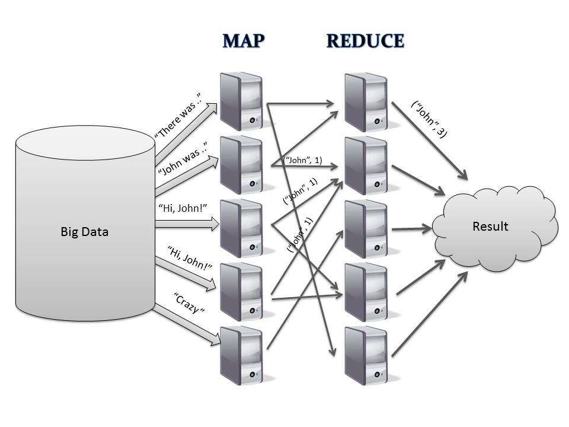

Slide 10
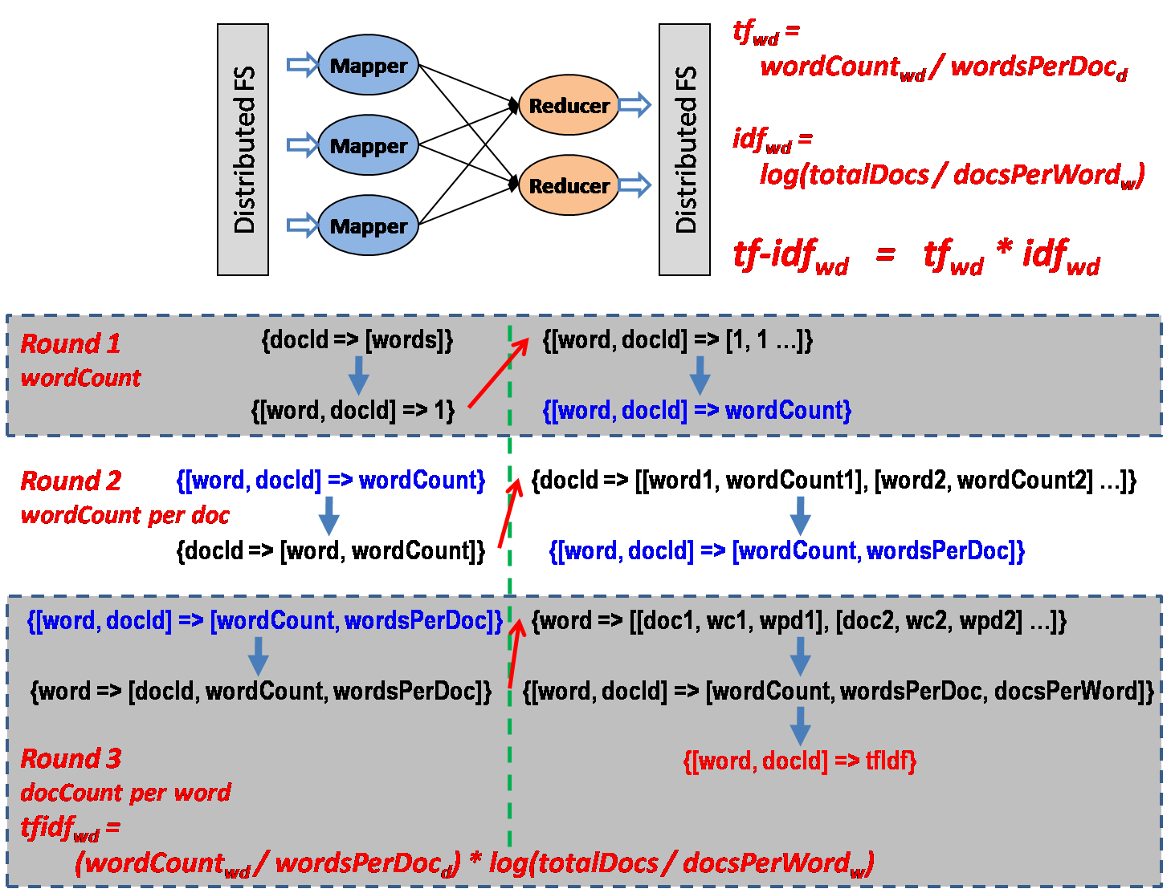

Slide 11
Map Reduce Using Amazon EMR
EMR: Elastic Map Reduce
Configure to support Map Reduce
Currently stuck on bootstrapping the EC2 instances

Slide 12
After Feature Extraction
Put Data into Amazon Redshift (simple, train-test split)
Use AWS Machine Learning to build the model (muti-class classification, can train dataset up to 100GB)
For multiclass classification, Amazon ML uses multinomial logistic regression (multinomial logistic loss + SGD).

Slide 13

Questions?

